Slide 2
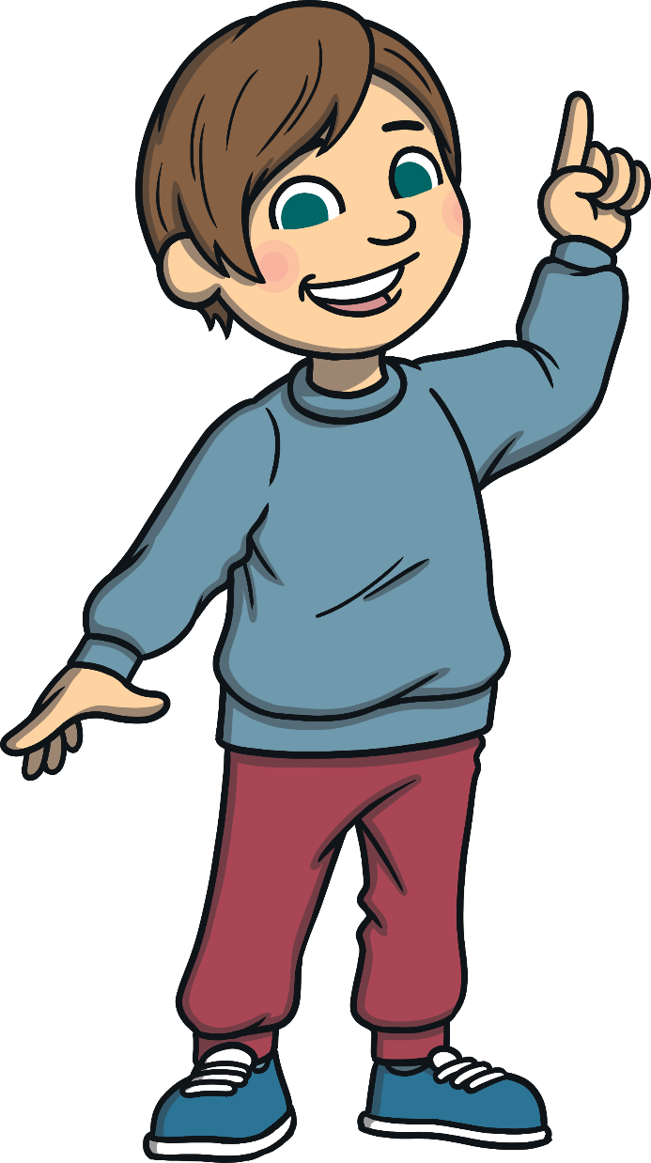
What Do I Do?
What Do I Do?
What Do I Do?
On each slide, you will see a picture.
You need to:
say what you see;
sound out the word using your fingers;
write the word on a whiteboard or a piece of paper.
Then, you can click to reveal the correct spelling. Will you get them all right?

Slide 3
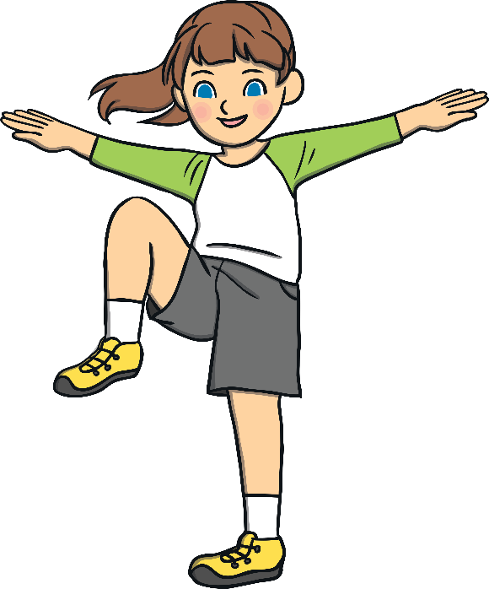

Alternative Spellings
Quick Write
Say what you see.
Write the word.
Remember to think about alternative spellings.
The correct spelling is…
knee
This word contains the alternative spelling kn.
Now, sound it out.

Slide 4
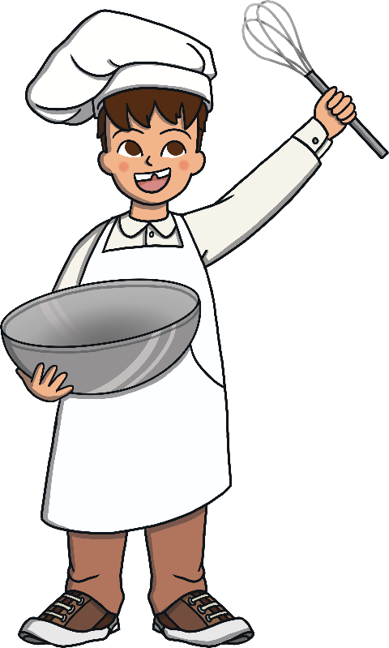
Alternative Spellings
Quick Write
Write the word.
Say what you see.
Remember to think about alternative spellings.
The correct spelling is…
chef
This word contains the alternative spelling ch.
Now, sound it out.

Slide 5
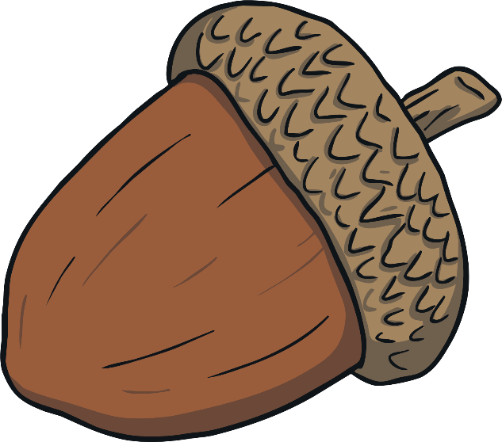
Alternative Spellings
Quick Write
Say what you see.
Write the word.
Remember to think about alternative spellings.
The correct spelling is…
acorn
This word contains the alternative spelling a.
Now, sound it out.

Slide 6
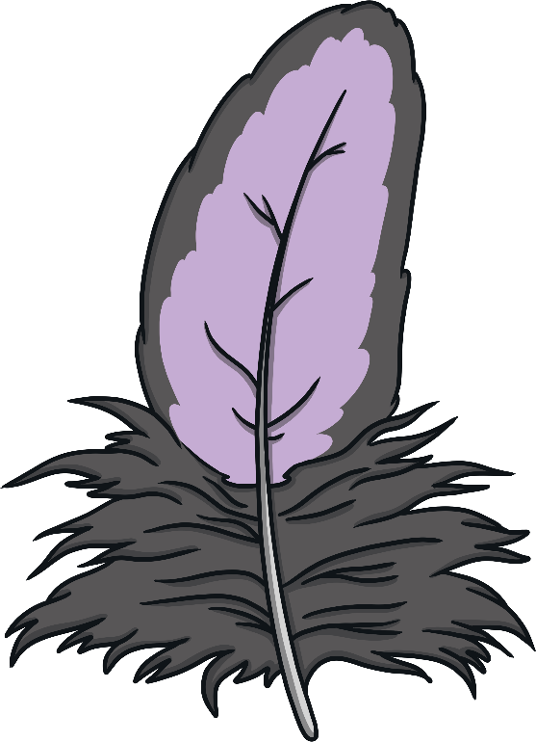
Alternative Spellings
Quick Write
Write the word.
Say what you see.
Remember to think about alternative spellings.
The correct spelling is…
feather
This word contains the alternative spelling ea.
Now, sound it out.

Slide 7
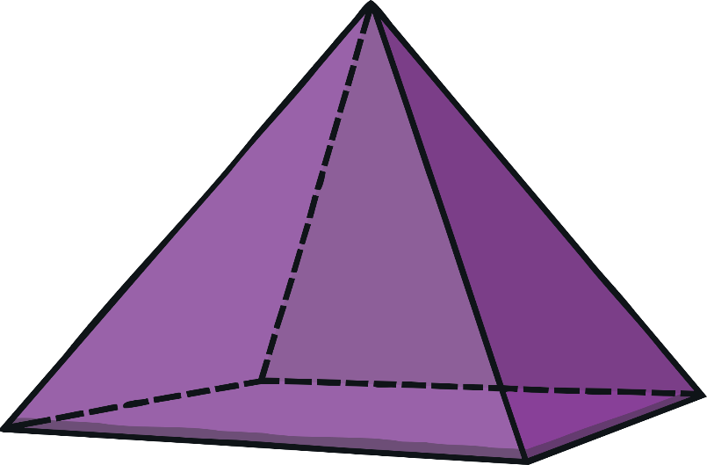
Alternative Spellings
Quick Write
Say what you see.
Write the word.
Remember to think about alternative spellings.
The correct spelling is…
pyramid
This word contains the alternative spelling y.
Now, sound it out.

Slide 8
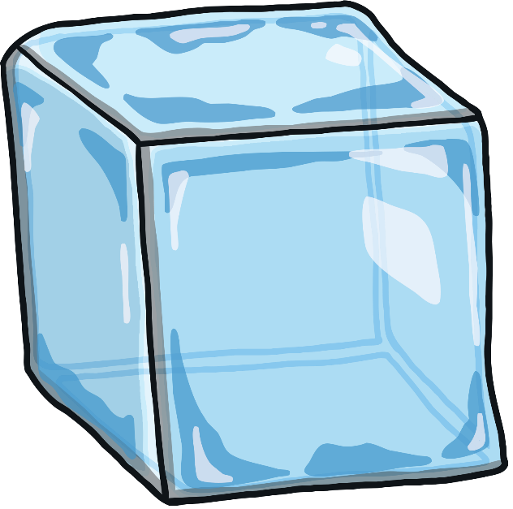
Alternative Spellings
Quick Write
Write the word.
Say what you see.
Remember to think about alternative spellings.
The correct spelling is…
ice
This word contains the alternative spelling c.
Now, sound it out.

Slide 9
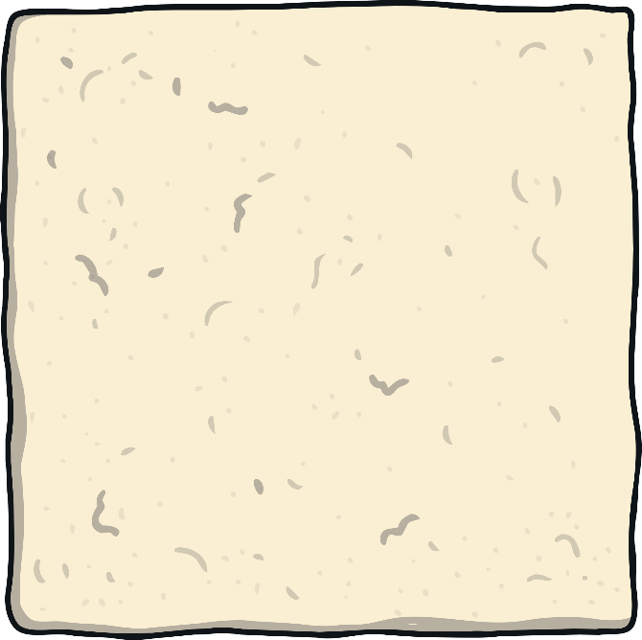
Alternative Spellings
Quick Write
Say what you see.
Write the word.
Remember to think about alternative spellings.
The correct spelling is…
square
This word contains the alternative spelling are.
Now, sound it out.

Slide 10
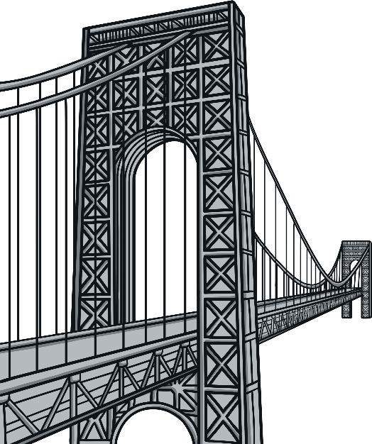
Alternative Spellings
Quick Write
Write the word.
Say what you see.
Remember to think about alternative spellings.
The correct spelling is…
bridge
This word contains the alternative spelling dge.
Now, sound it out.

Slide 11
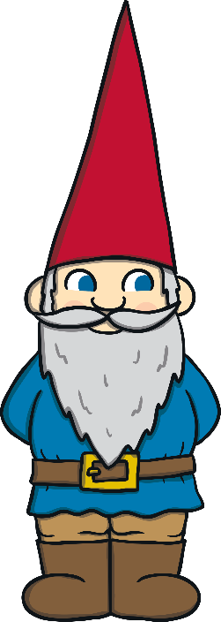
Alternative Spellings
Quick Write
Say what you see.
Write the word.
Remember to think about alternative spellings.
The correct spelling is…
gnome
This word contains the alternative spelling gn.
Now, sound it out.

Slide 12
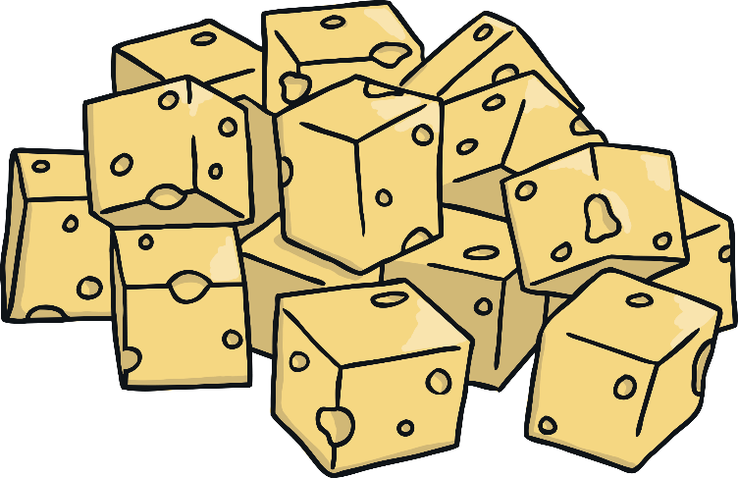
Alternative Spellings
Quick Write
Write the word.
Say what you see.
Remember to think about alternative spellings.
The correct spelling is…
cheese
This word contains the alternative spelling se.
Now, sound it out.

