Slide 1
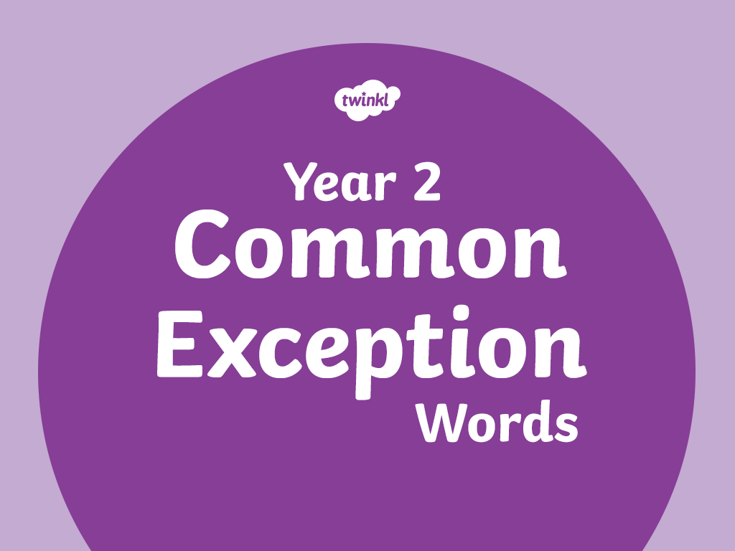

Slide 2
door

Slide 3
because

Slide 4
kind

Slide 5
floor

Slide 6
mind

Slide 7
gold

Slide 8
great

Slide 9
told

Slide 10
behind

Slide 11
poor

Slide 12
find

Slide 13
every

Slide 14
steak

Slide 15
pretty

Slide 16
beautiful

Slide 17
hold

Slide 18
after

Slide 19
break

Slide 20
fast

Slide 21
last

Slide 22
child

Slide 23
past

Slide 24
father

Slide 25
class

Slide 26
most

Slide 27
wild

Slide 28
children

Slide 29
grass

Slide 30
climb

Slide 31
pass

Slide 32
only

Slide 33
both

Slide 34
old

Slide 35
some

Slide 36
cold

Slide 37
plant

Slide 38
bath

Slide 39
move

Slide 40
hour

Slide 41
prove

Slide 42
path

Slide 43
sure

Slide 44
sugar

Slide 45
eye

Slide 46
could

Slide 47
improve

Slide 48
who

Slide 49
people

Slide 50
whole

Slide 51
should

Slide 52
water

Slide 53
any

Slide 54
would

Slide 55
many

Slide 56
clothes

Slide 57
busy

Slide 58
Mr

Slide 59
again

Slide 60
half

Slide 61
Mrs

Slide 62
everybody

Slide 63
money

Slide 64
even

Slide 65
parents

Slide 66
Christmas

Slide 67


